Slide 1

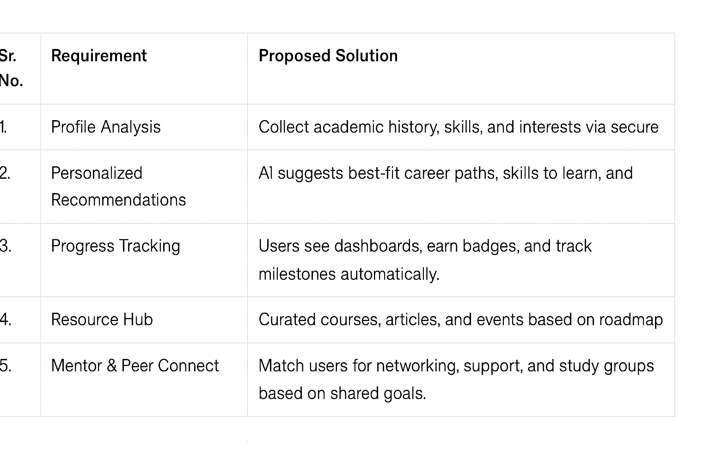
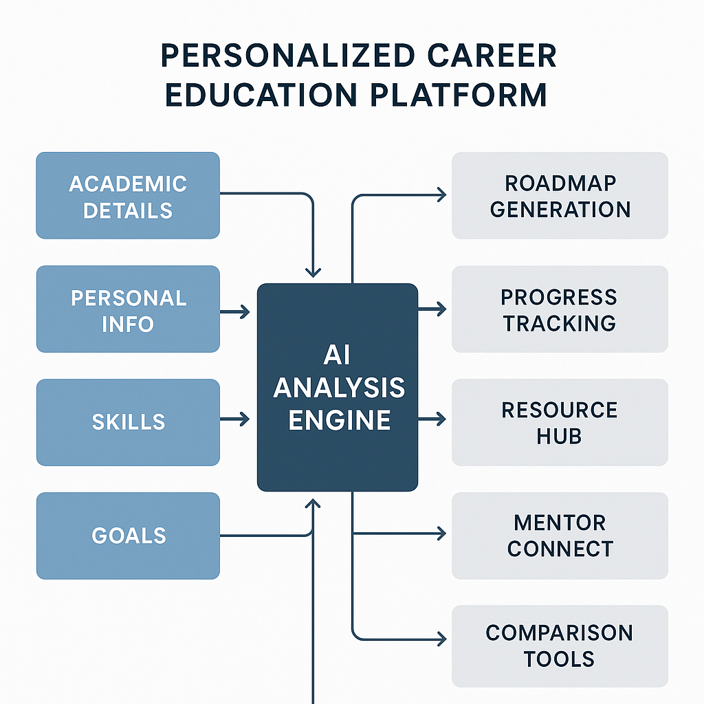
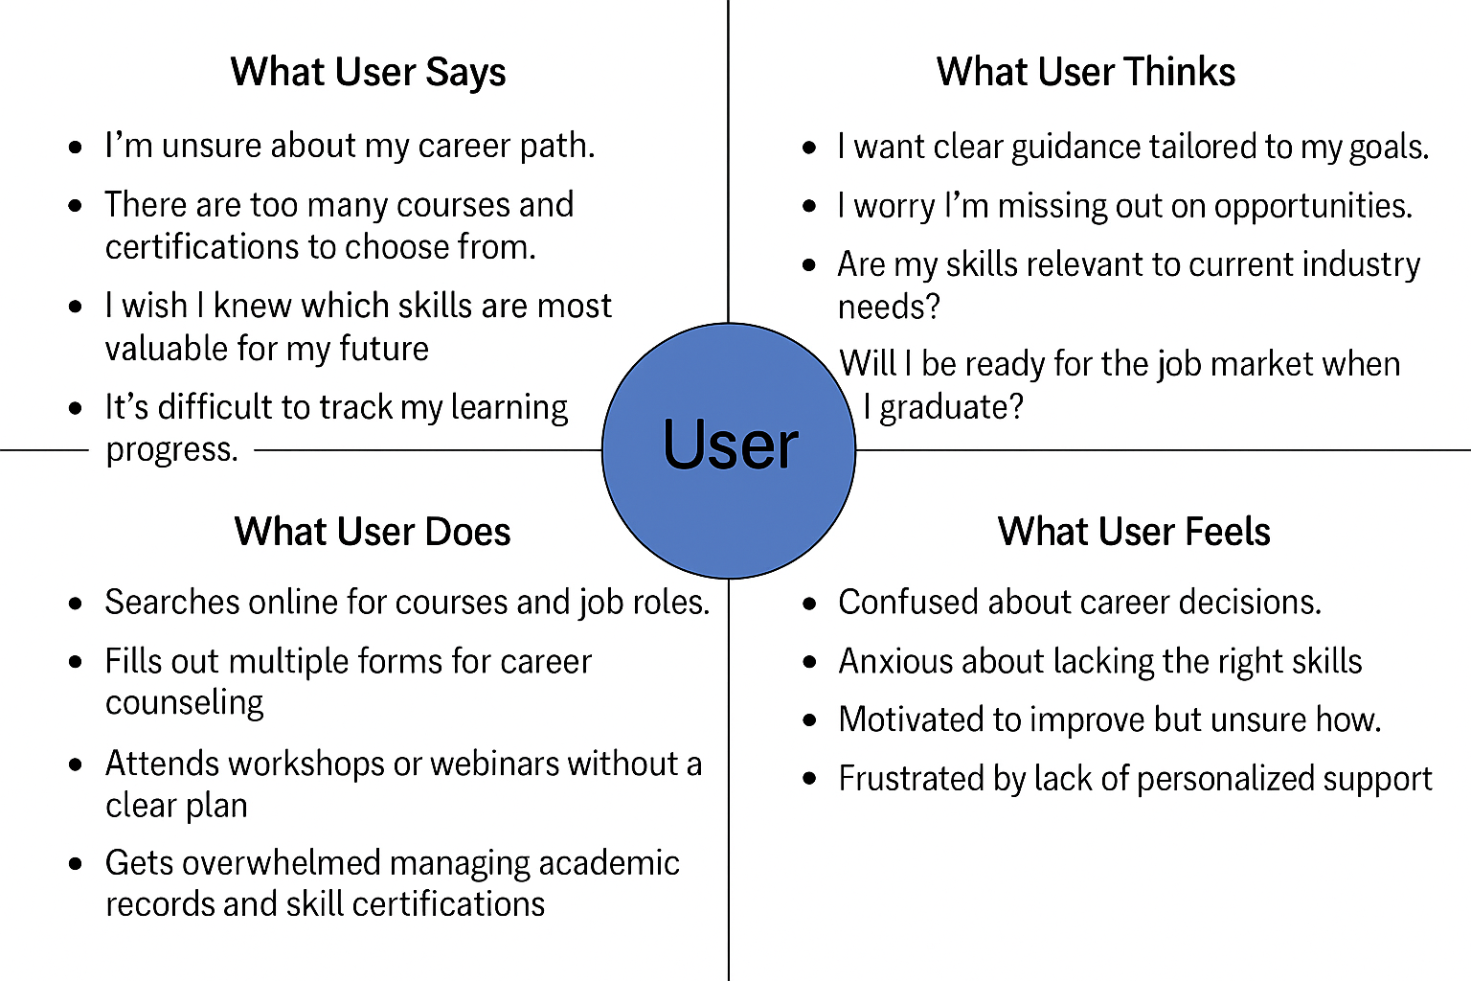
Proposed Architecture/ Diagram:
MIT SCHOOL OF COMPUTING
Class:TY DA&CORE
Group Id: 33
DEPARTMENT OF INFORMATION TECHNOLOGY
Personalized Academic & Career Roadmap Platform
Jagruti ghonge,Mrunali patil,Abhijeet shirke,Anas shaikh
Faculty Guide:
Prof. Palash Sontakke
Problem statement
Students in technology fields struggle with career planning due to lack of personalized guidance that matches their academic performance and interests with market demands. The overwhelming number of courses and certifications creates confusion about optimal career paths. Without integrated systems connecting academic history to career goals, students cannot create effective professional roadmaps, resulting in skill gaps and reduced employability upon graduation.
Proposed Solution
platform use AI to analyze users’ academic records, interests, and skills, generating a personalized roadmap with suggested courses, certifications, and career paths. Users will monitor their progress through interactive dashboards and , access curated resources for upskilling, and connect with mentors or peers for targeted networking. The system will ensure secure data management and empowering users to make informed decisions and maximize their career opportunities.
Scope and Feasibility
The platform offers personalized academic and career guidance using student data and AI analysis, with scalable features for resource recommendations, progress tracking, and mentor connections. It is practical and achievable with current web technologies and AI tools, making it suitable for educational and professional development use.

